Slide 1
Today
Gibbs energy and non-PV work
What non-PV work is
Relationship between non-PV work and G

Slide 2
Non-PV work (of concentration)
State “Y”
You’d have to do work on this system to get it from X to Y
State “X”

Slide 3
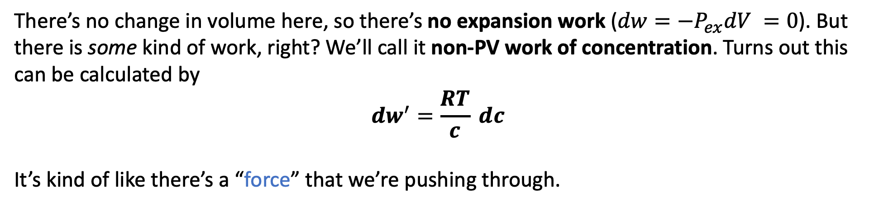
Non-PV work (of concentration)
State “Y”
You’d have to do work on this system to get it from X to Y
State “X”
There’s no change in volume here, so there’s no expansion work ($dw=−P_{ex}dV =0$). But there is some kind of work, right? We’ll call it non-PV work of concentration. Turns out this can be calculated by
$${dw}^{′}=\frac{RT}{c} dc$$
It’s kind of like there’s a “force” that we’re pushing through.

Slide 4
Non-PV work (of concentration)
State “Y”
You’d have to do work on this system to get it from X to Y
State “X”
There’s no change in volume here, so there’s no expansion work ($dw=−P_{ex}dV =0$). But there is some kind of work, right? We’ll call it non-PV work of concentration. Turns out this can be calculated by
$${dw}^{′}=\frac{RT}{c} dc$$
It’s kind of like there’s a “force” that we’re pushing through.

Slide 5


Calculating the non-PV work of concentration
$$dc$$
For a small change in concentration like this, we have
$${dw}^{′}=\frac{RT}{c}dc$$

Slide 6
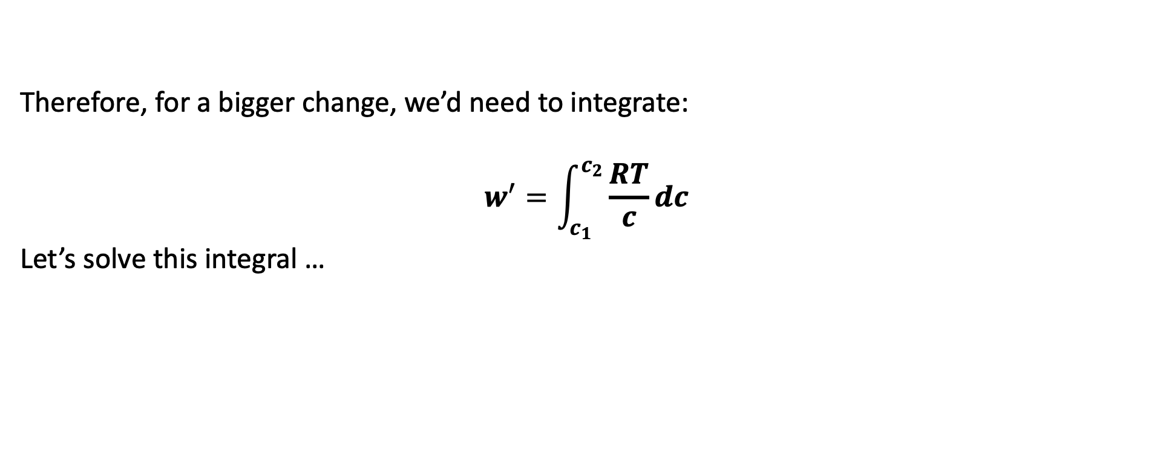


Calculating the non-PV work of concentration
$$c_{1}$$
$$c_{2}$$
Therefore, for a bigger change, we’d need to integrate:
$$w^{′}=\int_{c_{1}}^{c_{2}}{\frac{RT}{c}dc}$$
Let’s solve this integral …

Slide 7
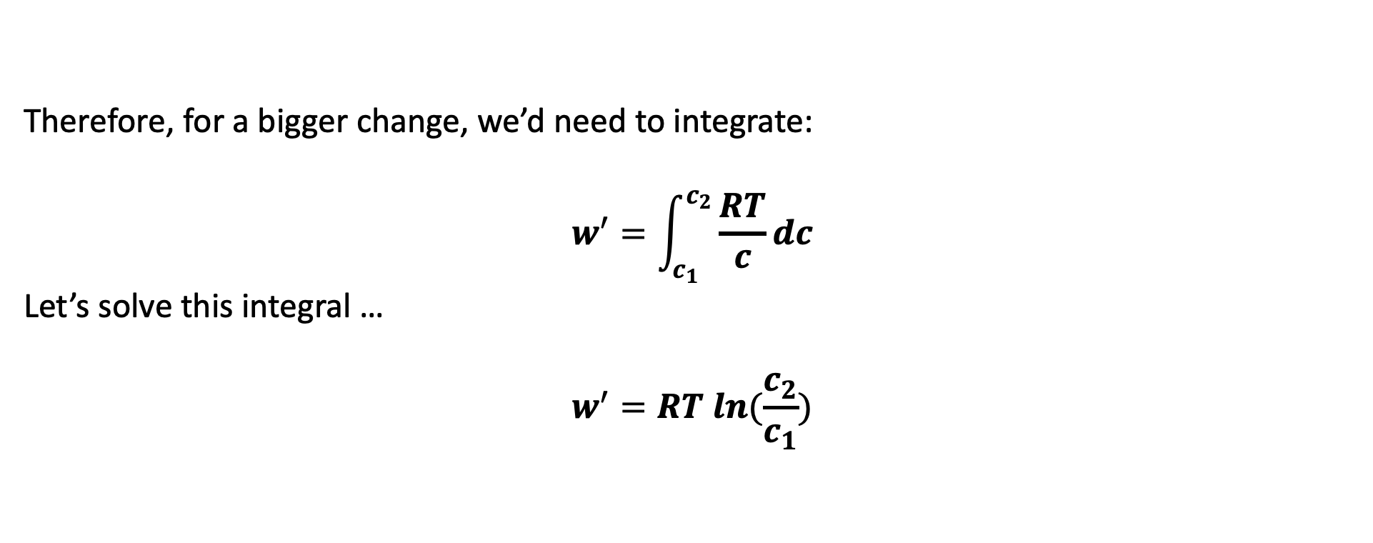
Calculating the non-PV work of concentration
$$c_{1}$$
$$c_{2}$$
Therefore, for a bigger change, we’d need to integrate:
$$w^{′}=\int_{c_{1}}^{c_{2}}{\frac{RT}{c}dc}$$
Let’s solve this integral …
$$w^{′}=RT ln(\frac{c_{2}}{c_{1}})$$

Slide 8
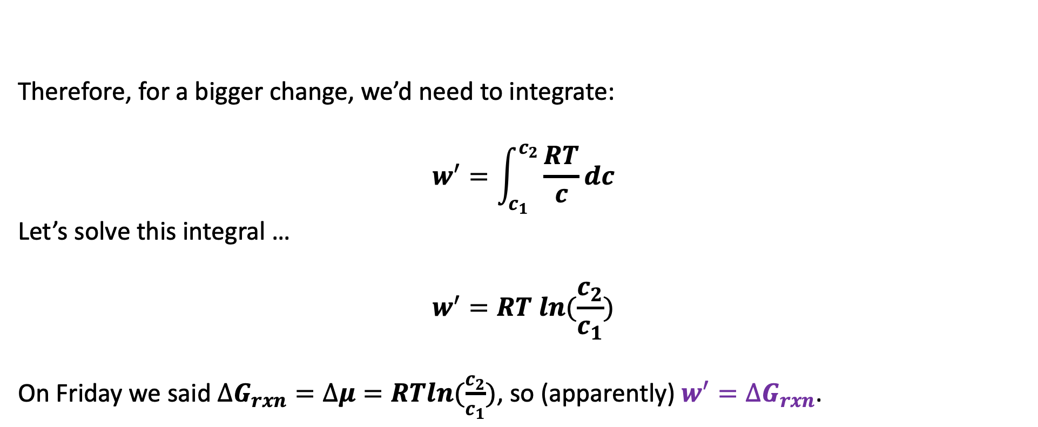
Calculating the non-PV work of concentration
$$c_{1}$$
$$c_{2}$$
Therefore, for a bigger change, we’d need to integrate:
$$w^{′}=\int_{c_{1}}^{c_{2}}{\frac{RT}{c}dc}$$
Let’s solve this integral …
$$w^{′}=RT ln(\frac{c_{2}}{c_{1}})$$
On Friday we said $∆G_{rxn}=∆μ=RTln(\frac{c_{2}}{c_{1}})$, so (apparently) $w^{′}=∆G_{rxn}$.

Slide 9
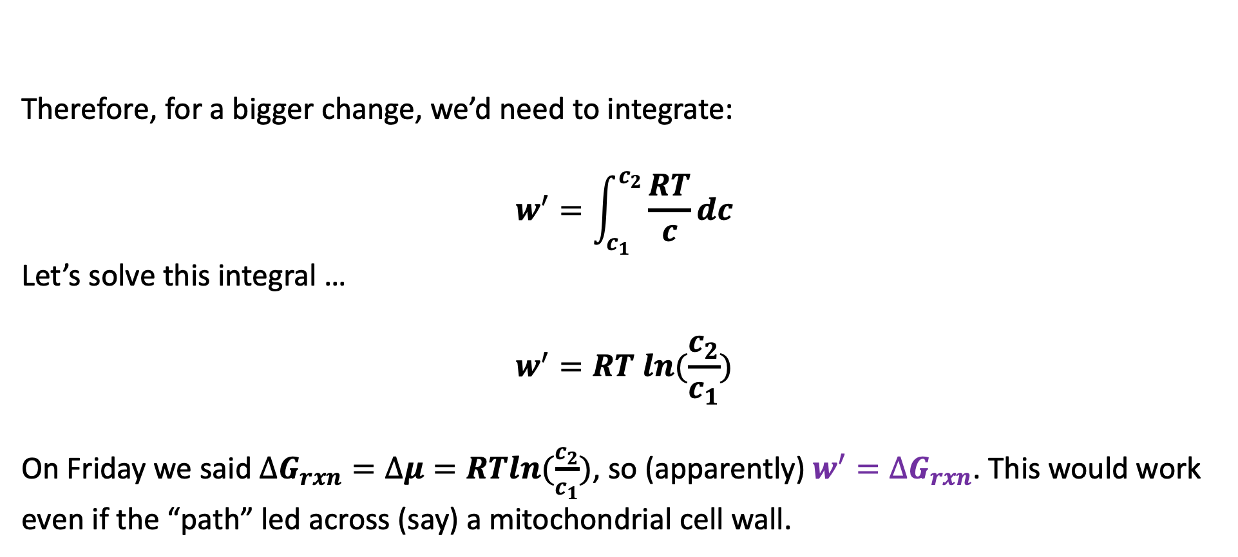
Calculating the non-PV work of concentration
$$c_{1}$$
$$c_{2}$$
Therefore, for a bigger change, we’d need to integrate:
$$w^{′}=\int_{c_{1}}^{c_{2}}{\frac{RT}{c}dc}$$
Let’s solve this integral …
$$w^{′}=RT ln(\frac{c_{2}}{c_{1}})$$
On Friday we said $∆G_{rxn}=∆μ=RTln(\frac{c_{2}}{c_{1}})$, so (apparently) $w^{′}=∆G_{rxn}$. This would work even if the “path” led across (say) a mitochondrial cell wall.

Slide 10
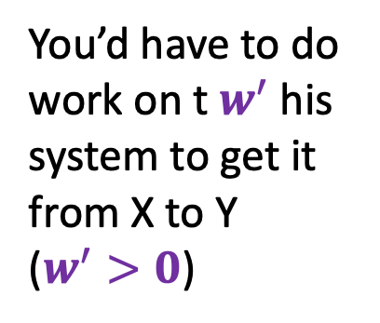
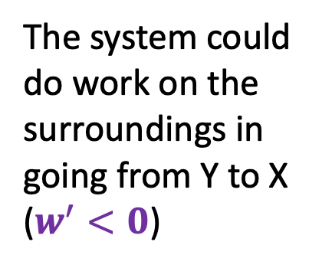
More general comments about non-PV work of concentration
State “Y”
You’d have to do work on t $w^{′}$his system to get it from X to Y ($w^{′}>0$)
The system could do work on the surroundings in going from Y to X ($w^{′}<0$)
State “X”

Slide 11
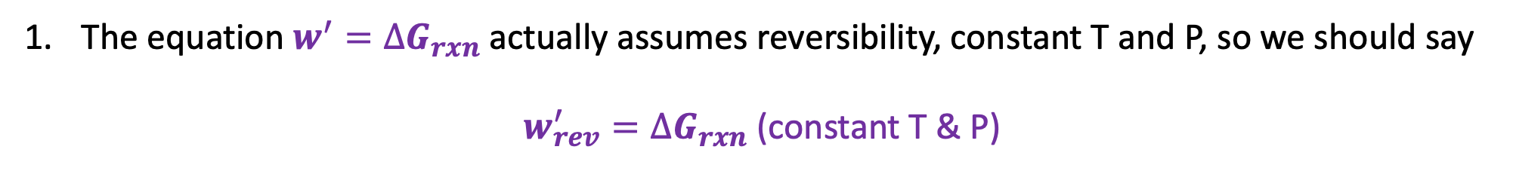
More general comments about non-PV work of concentration
State “Y”
You’d have to do work on t $w^{′}$his system to get it from X to Y ($w^{′}>0$)
The system could do work on the surroundings in going from Y to X ($w^{′}<0$)
State “X”
The equation $w^{′}=∆G_{rxn}$actually assumes reversibility, constant T and P, so we should say
$w_{rev}^{′}=∆G_{rxn}$ (constant T & P)

Slide 12

More general comments about non-PV work of concentration
State “Y”
You’d have to do work on t $w^{′}$his system to get it from X to Y ($w^{′}>0$)
The system could do work on the surroundings in going from Y to X ($w^{′}<0$)
State “X”
The equation $w^{′}=∆G_{rxn}$actually assumes reversibility, constant T and P, so we should say
$w_{rev}^{′}=∆G_{rxn}$ (constant T & P)
In real life, inefficiencies in how X is converted to Y mean that $∆G_{rxn}$defines a lower thermodynamic limit on the necessary work: |$w_{actual}^{′} |≥|∆G_{rxn}|$.

Slide 13
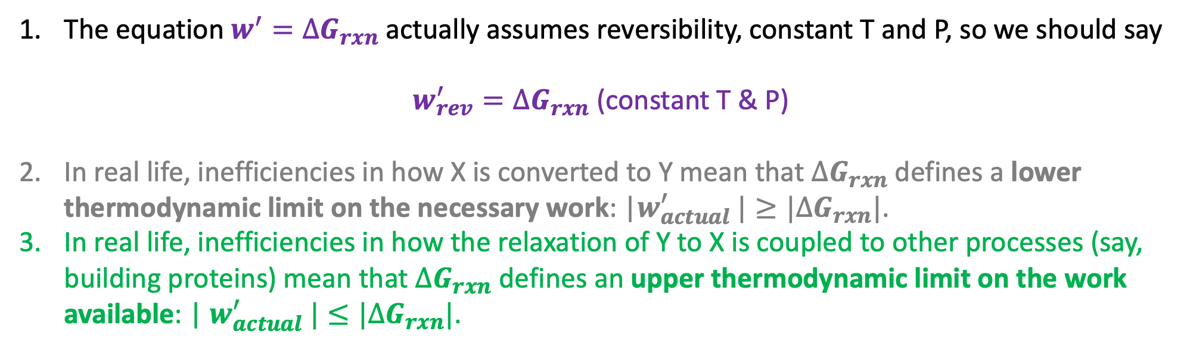
More general comments about non-PV work of concentration
State “Y”
You’d have to do work on t $w^{′}$his system to get it from X to Y ($w^{′}>0$)
The system could do work on the surroundings in going from Y to X ($w^{′}<0$)
State “X”
The equation $w^{′}=∆G_{rxn}$actually assumes reversibility, constant T and P, so we should say
$w_{rev}^{′}=∆G_{rxn}$ (constant T & P)
In real life, inefficiencies in how X is converted to Y mean that $∆G_{rxn}$defines a lower thermodynamic limit on the necessary work: |$w_{actual}^{′} |≥|∆G_{rxn}|$.
In real life, inefficiencies in how the relaxation of Y to X is coupled to other processes (say, building proteins) mean that $∆G_{rxn}$ defines an upper thermodynamic limit on the work available: | $w_{actual}^{′} |≤|∆G_{rxn}|$.

